Slide 1
Non-regular languages
(Pumping Lemma)
Costas Busch - LSU
‹#›
Notes:
‹#›

Slide 2
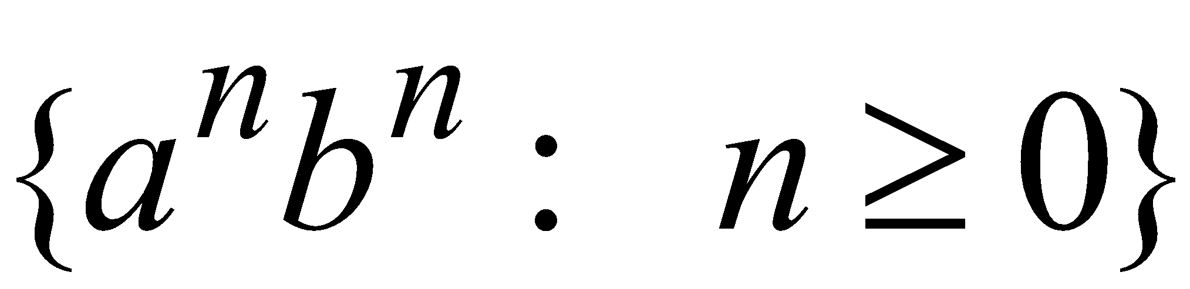
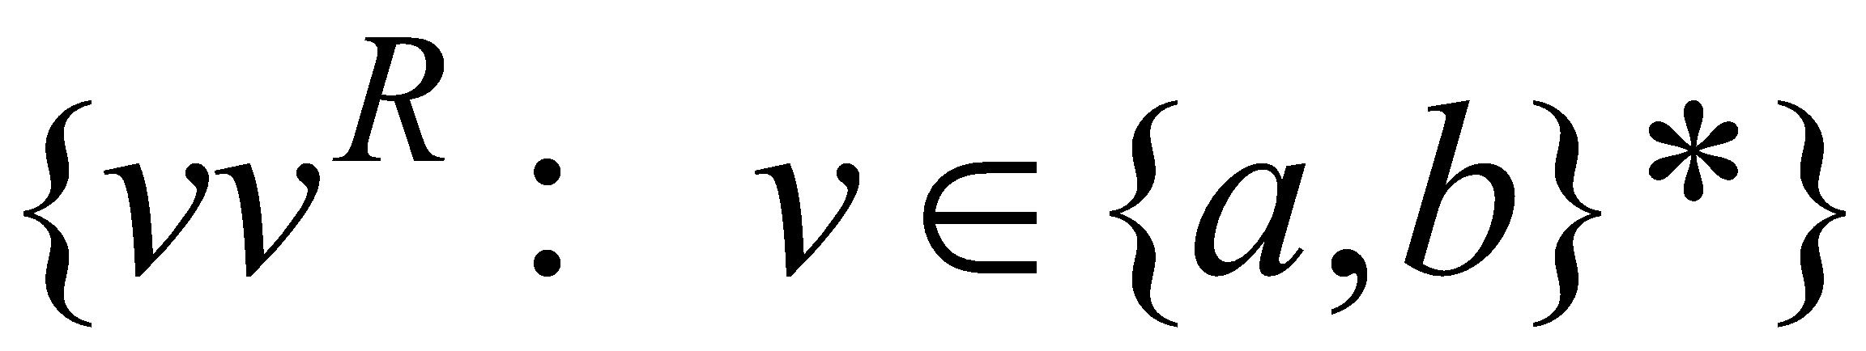
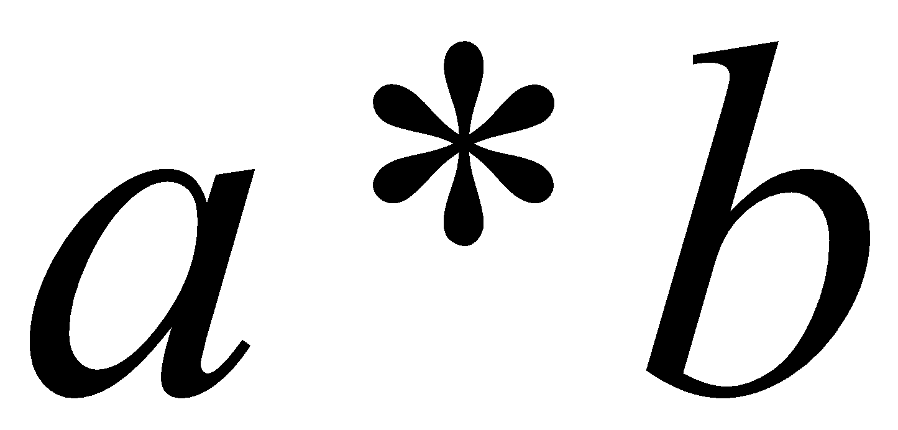
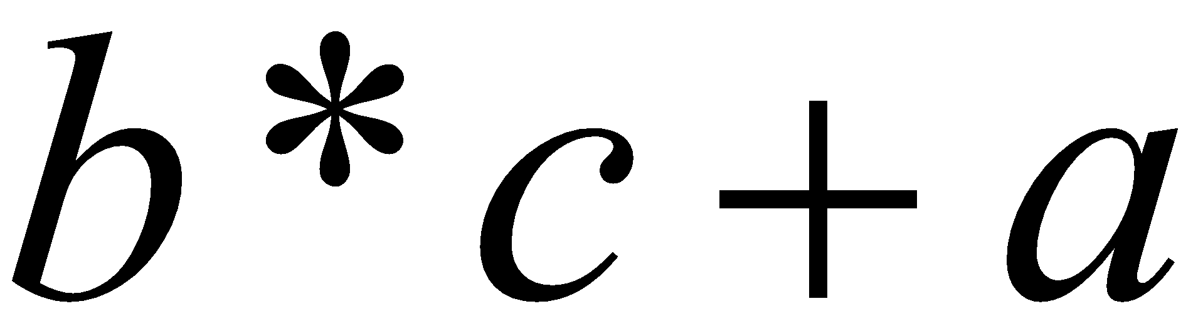
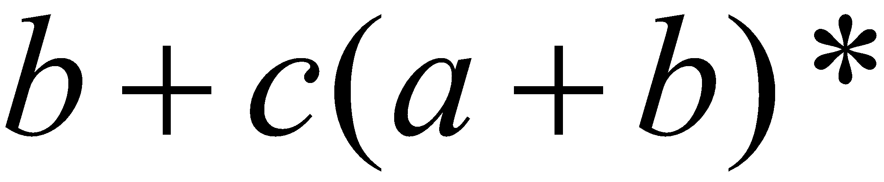
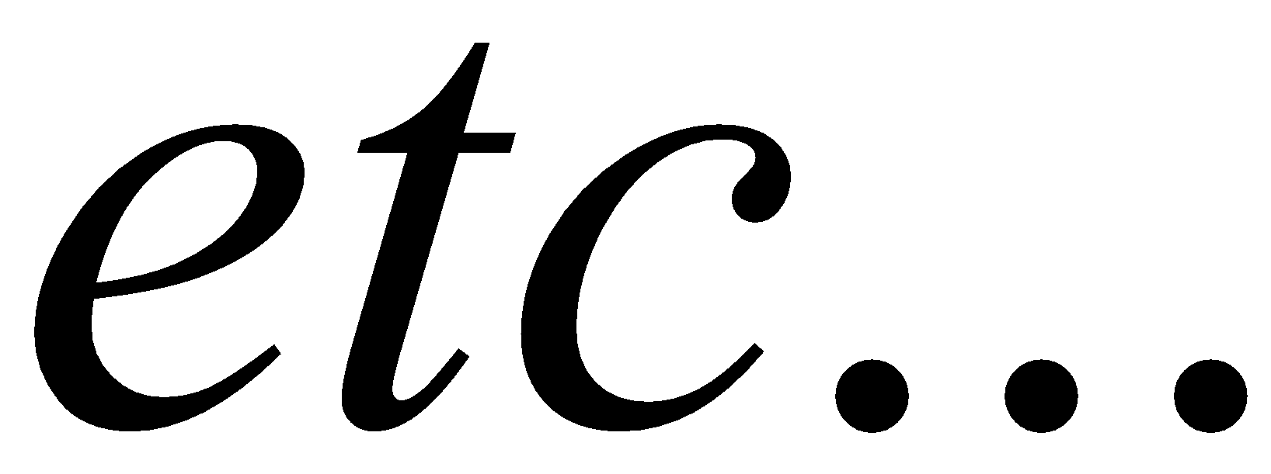
Non-regular languages
Regular languages
Costas Busch - LSU
‹#›

Slide 3
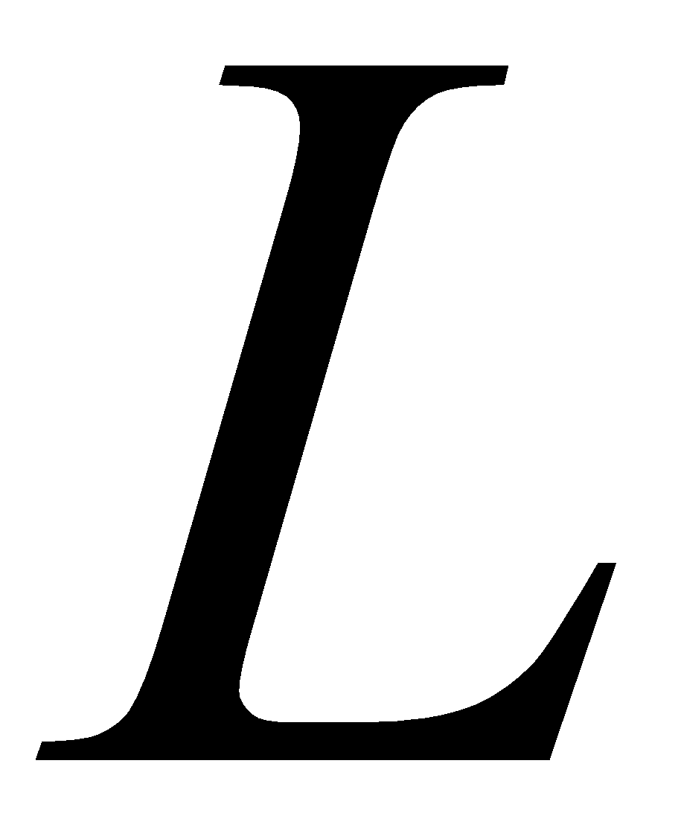
How can we prove that a language
is not regular?
Prove that there is no DFA or NFA or RE
that accepts
Difficulty: this is not easy to prove
(since there is an infinite number of them)
Solution: use the Pumping Lemma !!!
Costas Busch - LSU
‹#›

Slide 4

The Pigeonhole Principle
Costas Busch - LSU
‹#›

Slide 5


pigeons
pigeonholes
Costas Busch - LSU
‹#›

Slide 6
A pigeonhole must
contain at least two pigeons
Costas Busch - LSU
‹#›

Slide 7
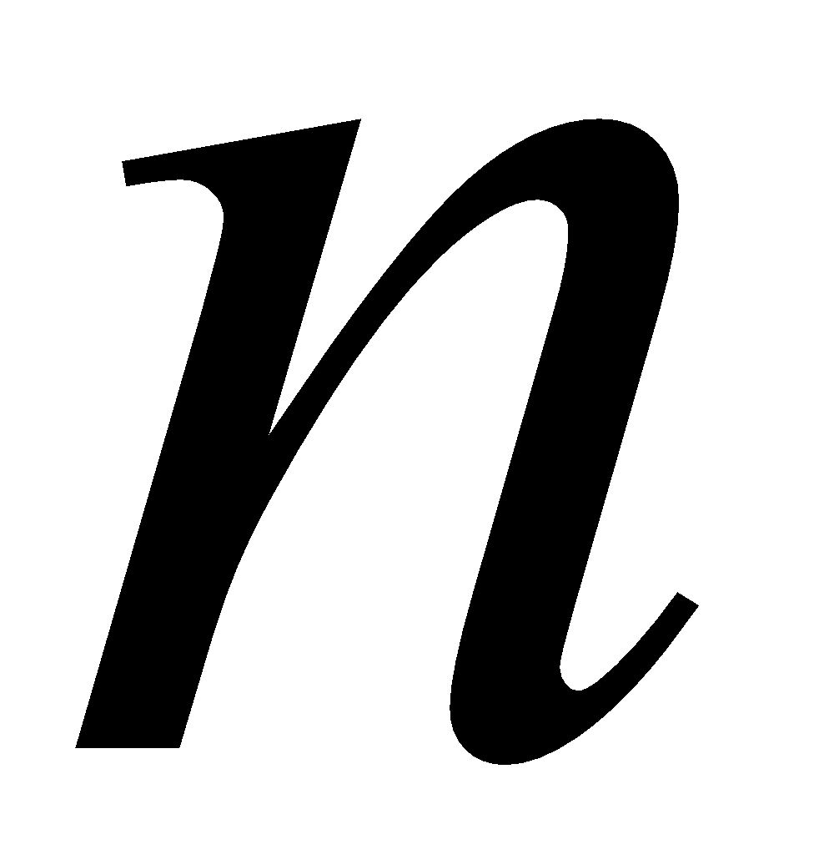
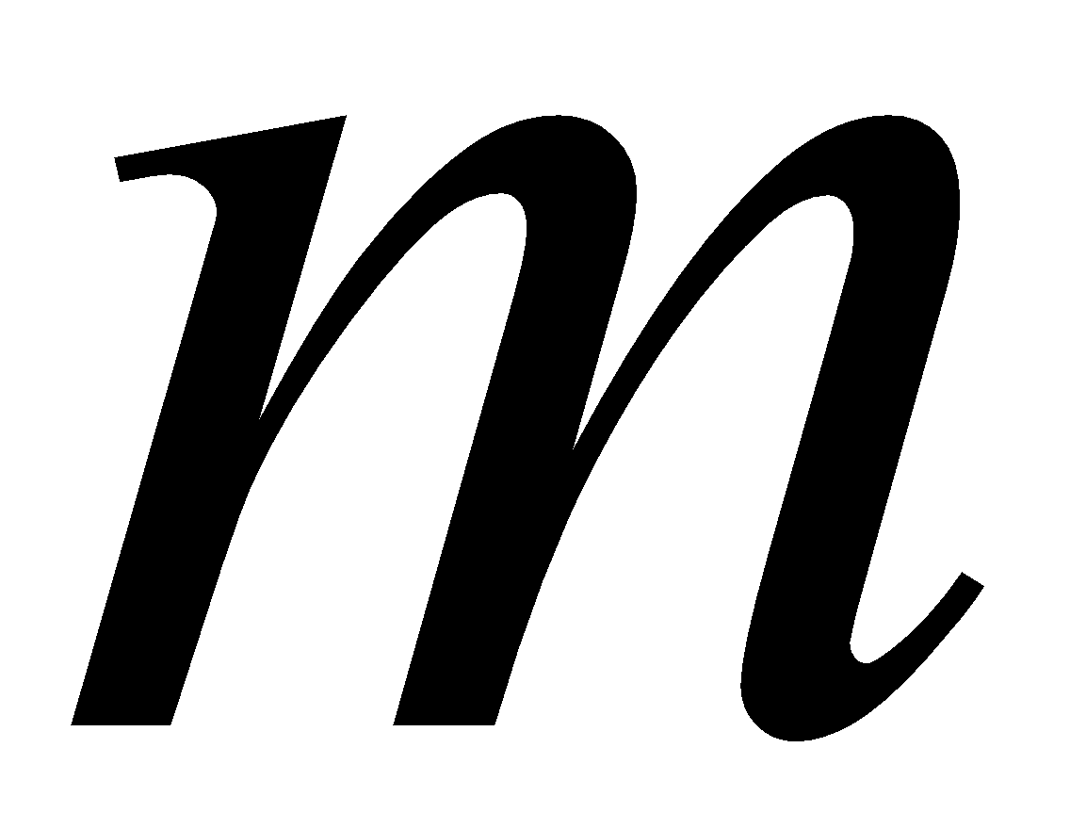
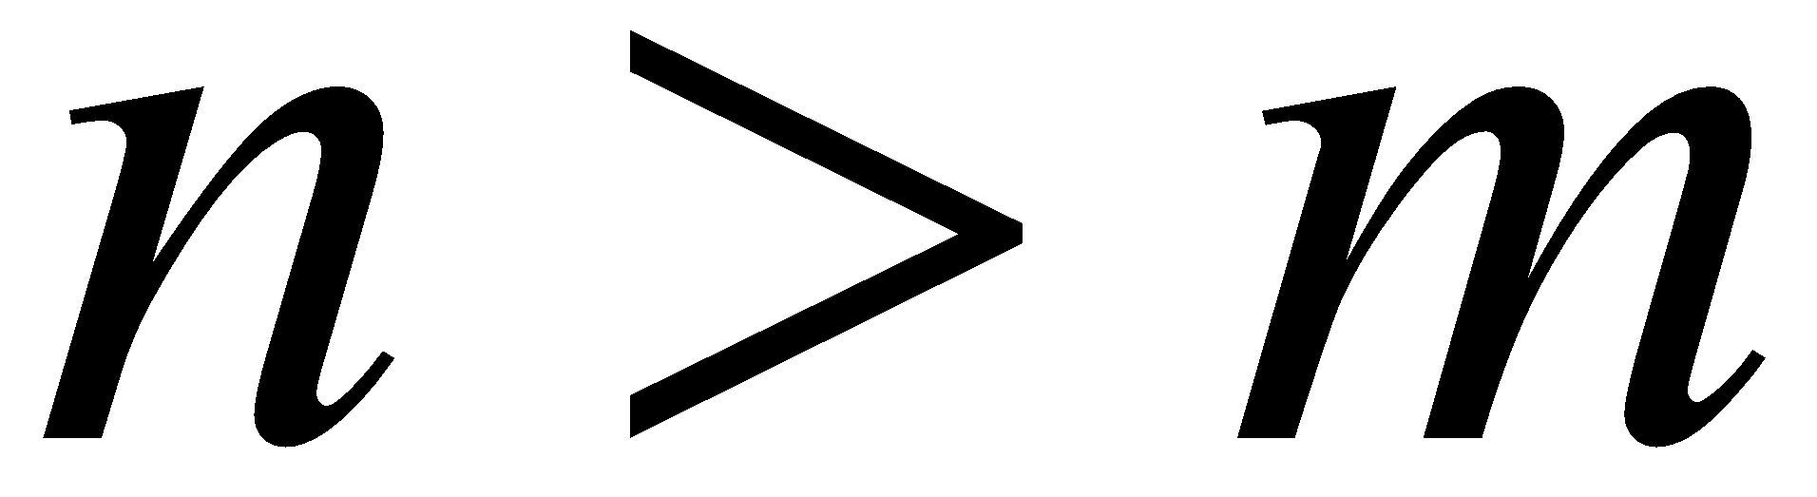
pigeons
...........
pigeonholes
...........
Costas Busch - LSU
‹#›

Slide 8
The Pigeonhole Principle
pigeons
pigeonholes
There is a pigeonhole
with at least 2 pigeons
...........
Costas Busch - LSU
‹#›

Slide 9
The Pigeonhole Principle and DFAs
Costas Busch - LSU
‹#›

Slide 10

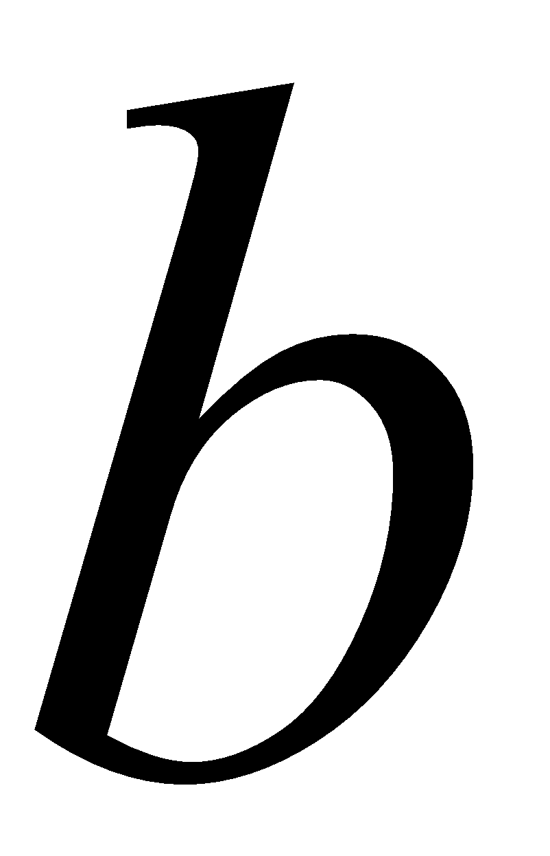
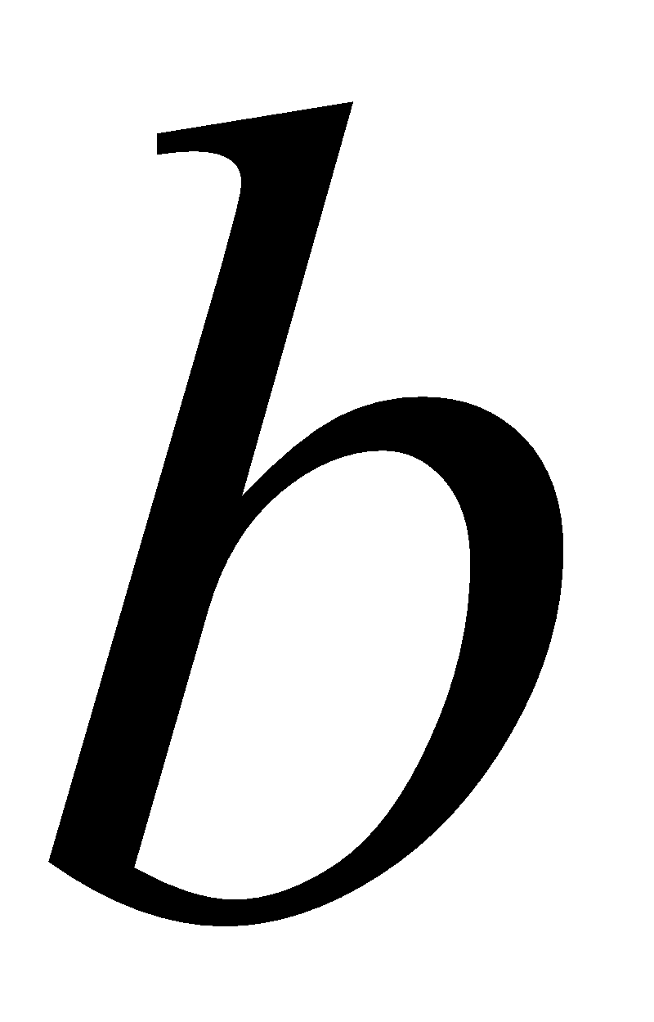
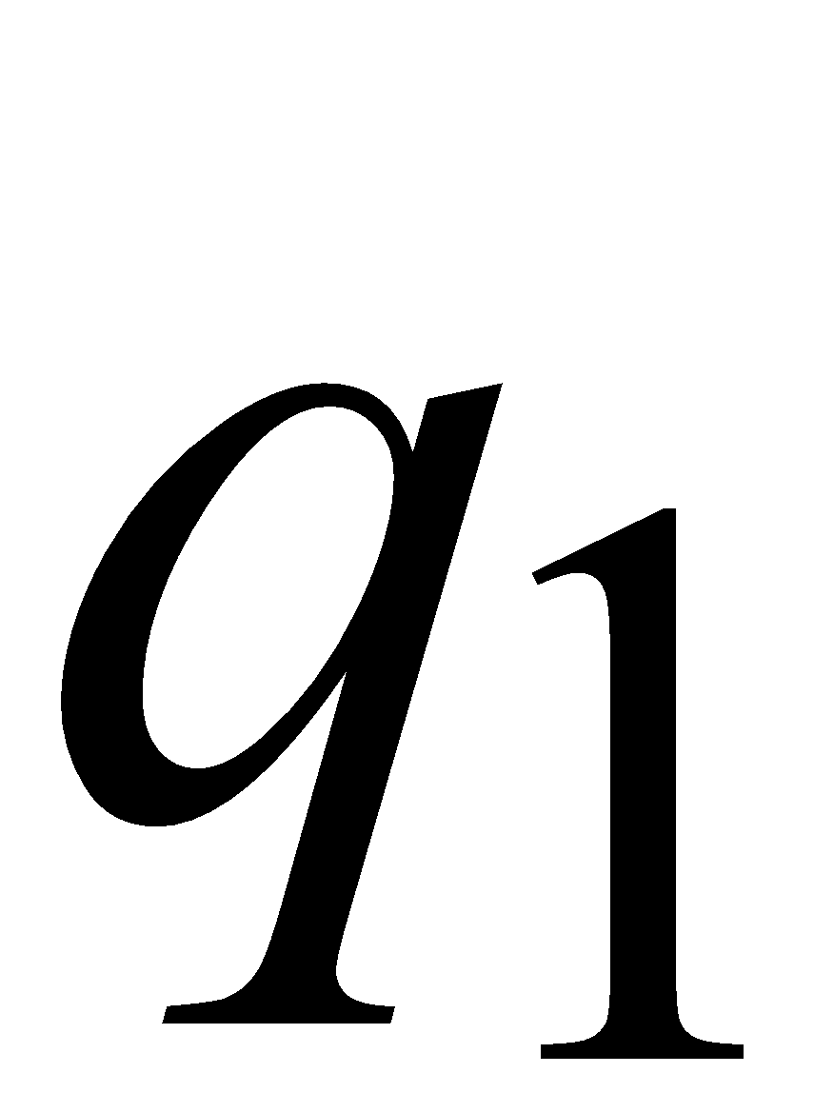
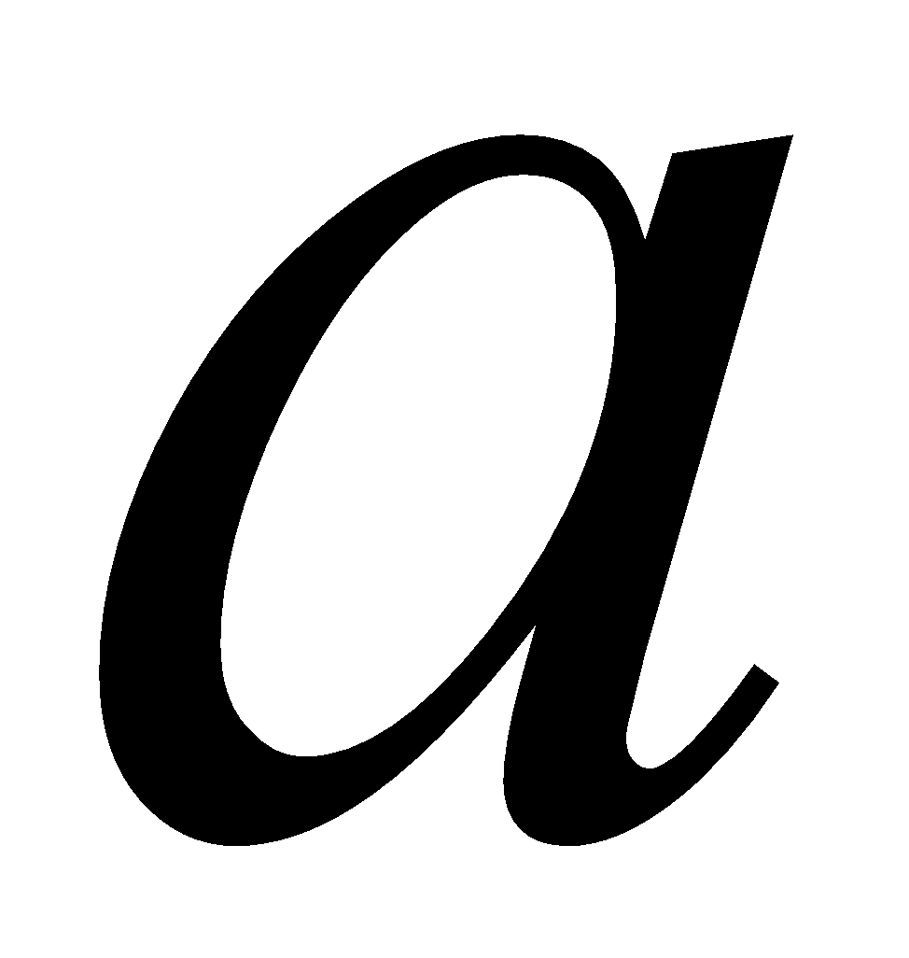
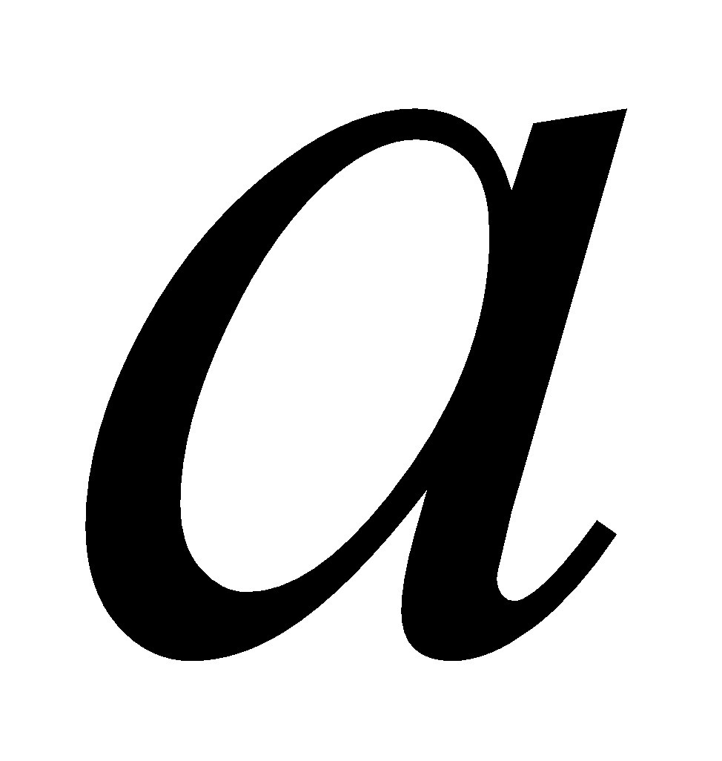
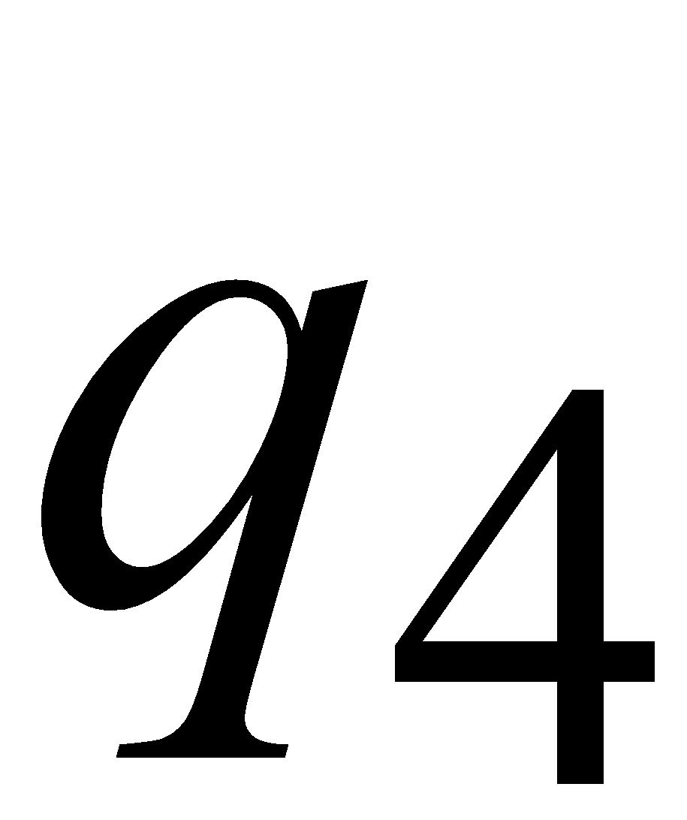
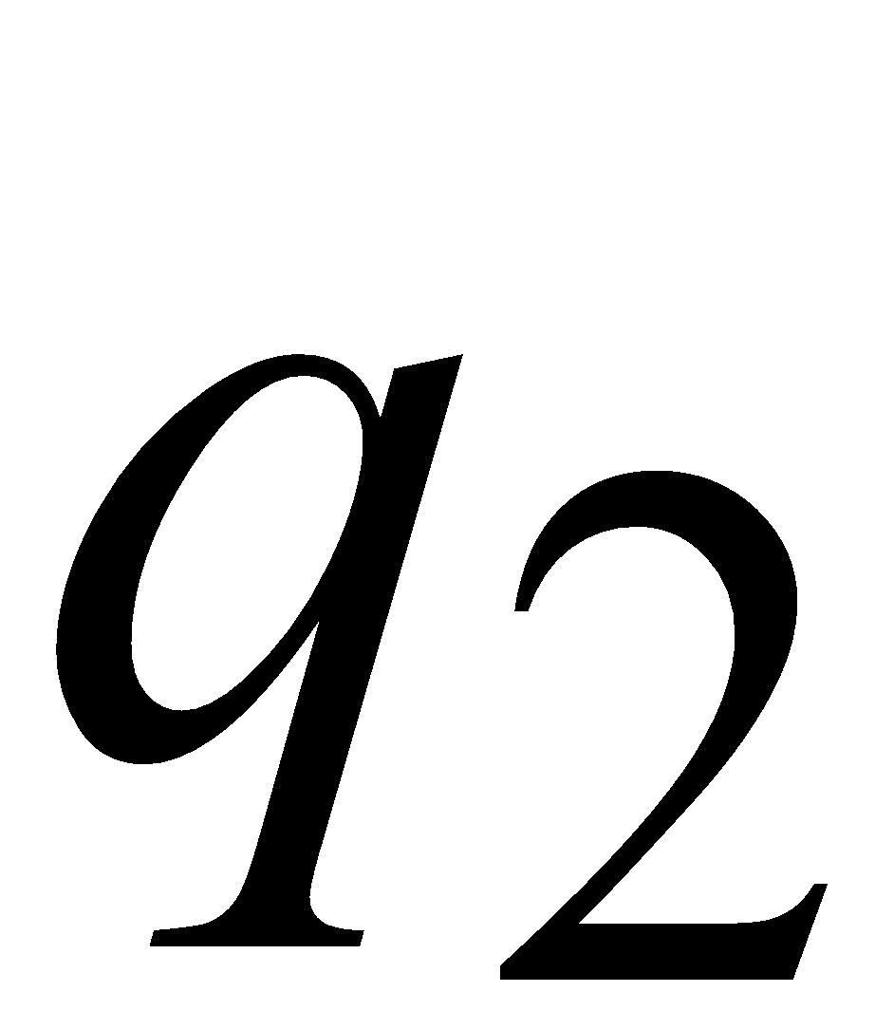
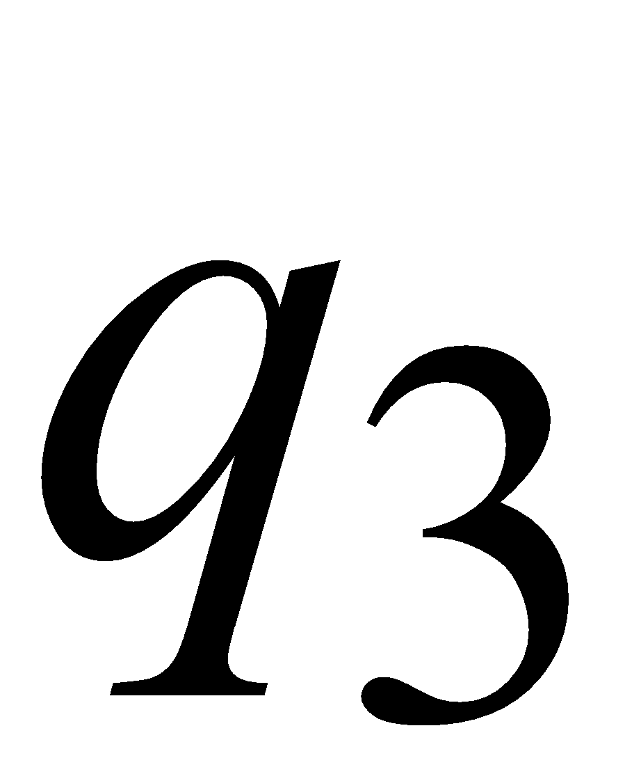
Consider a DFA with states
Costas Busch - LSU
‹#›

Slide 11
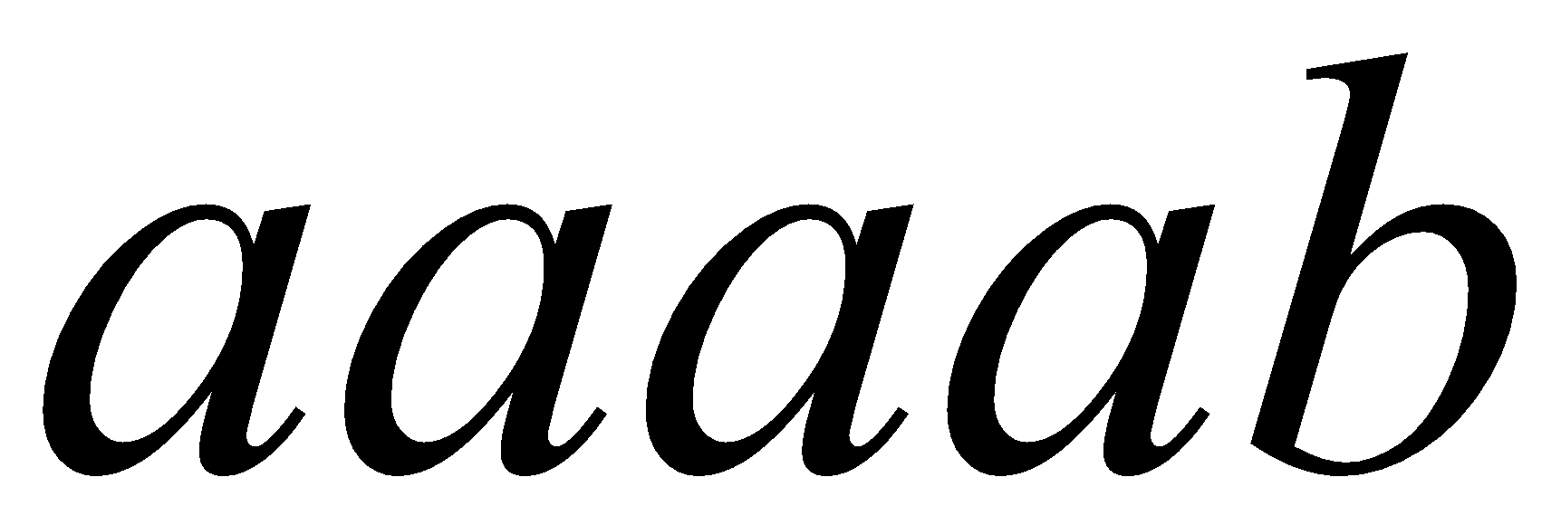
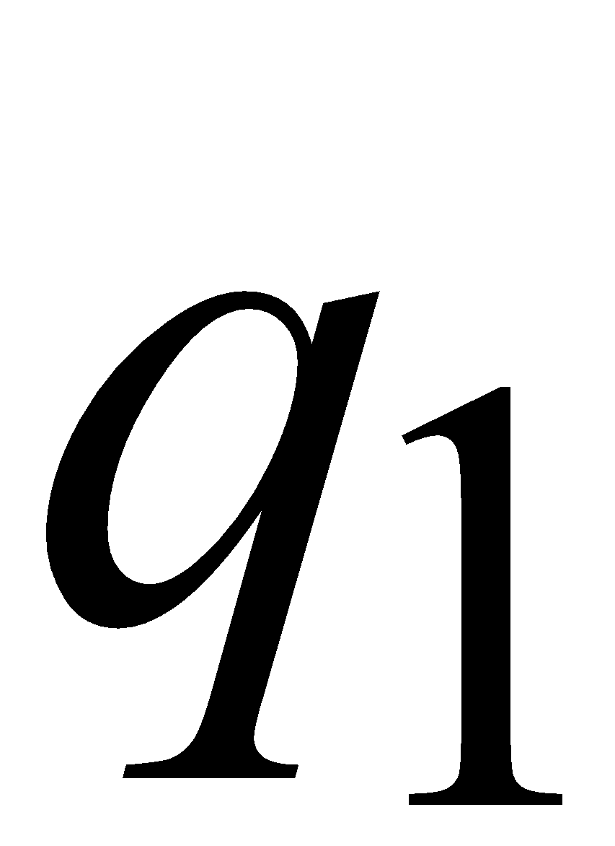
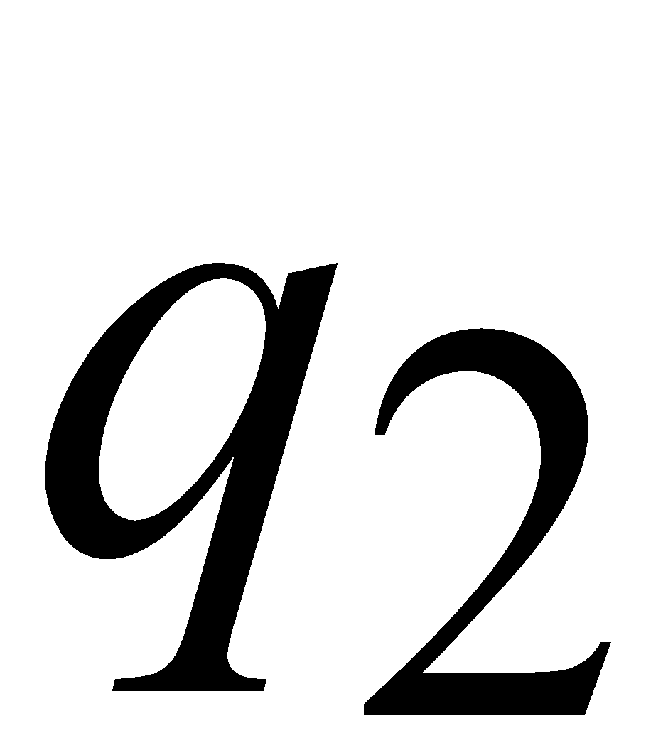
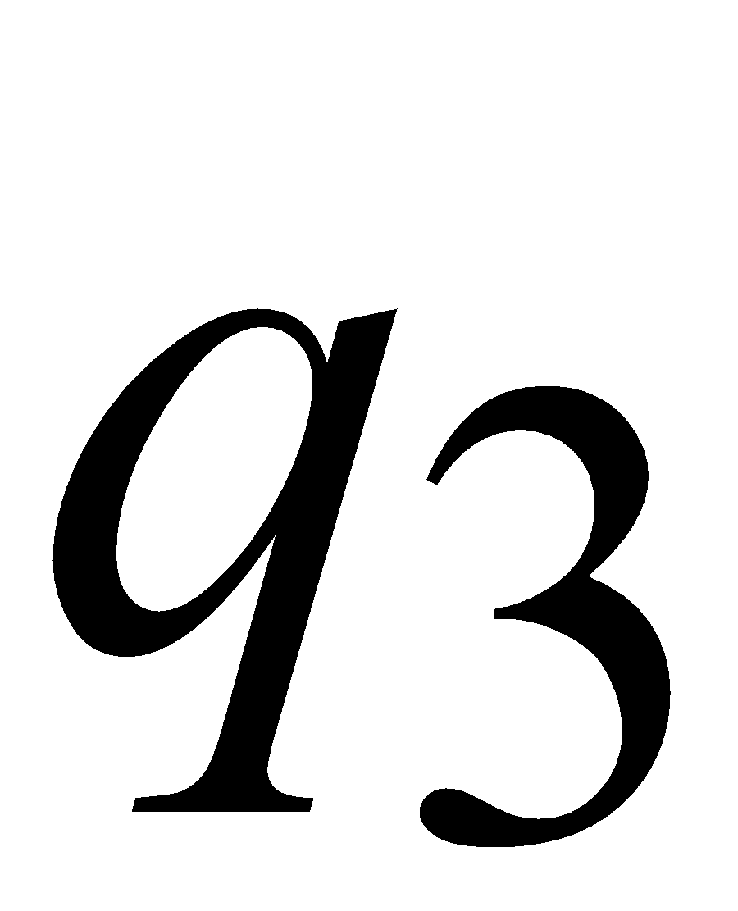
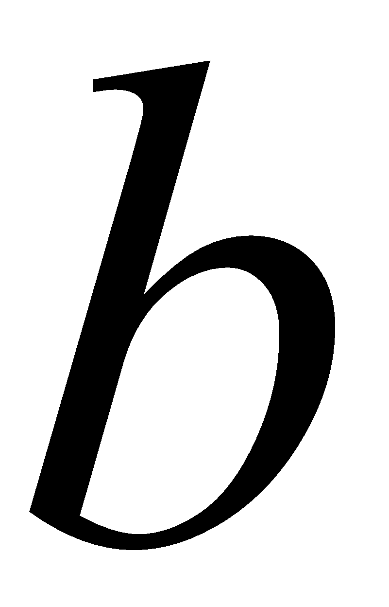
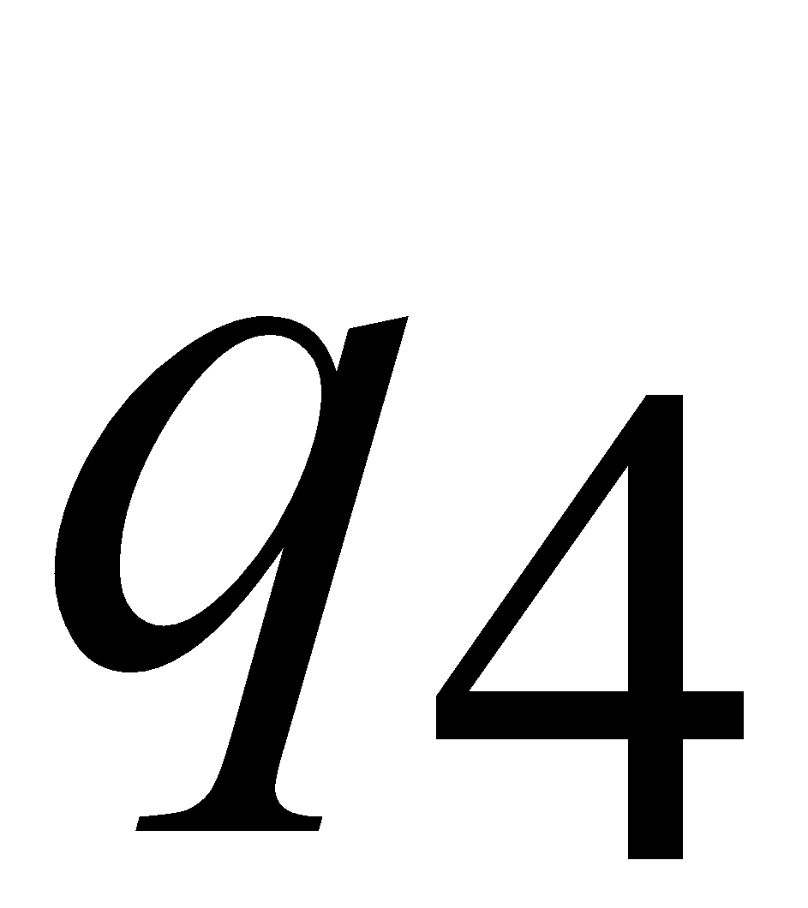
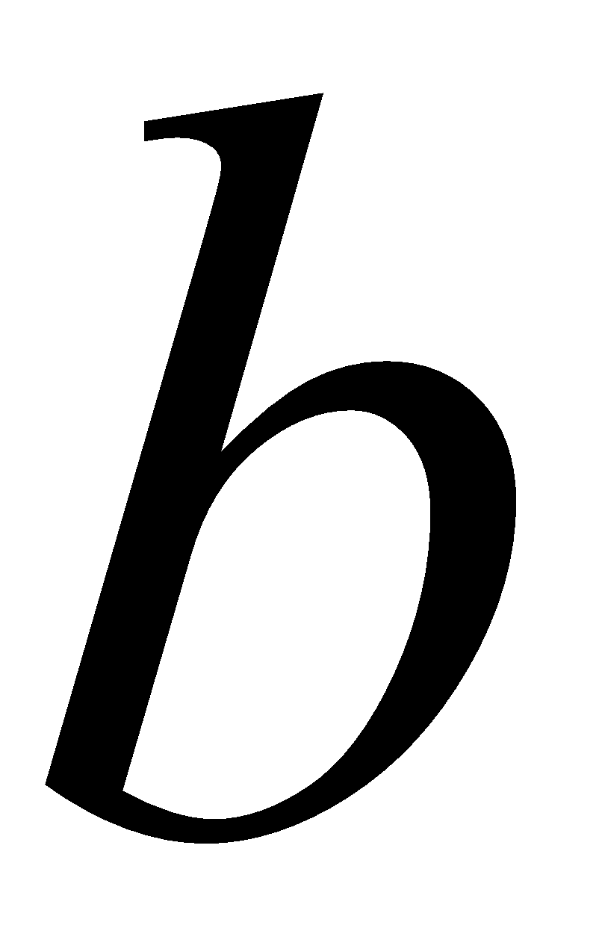
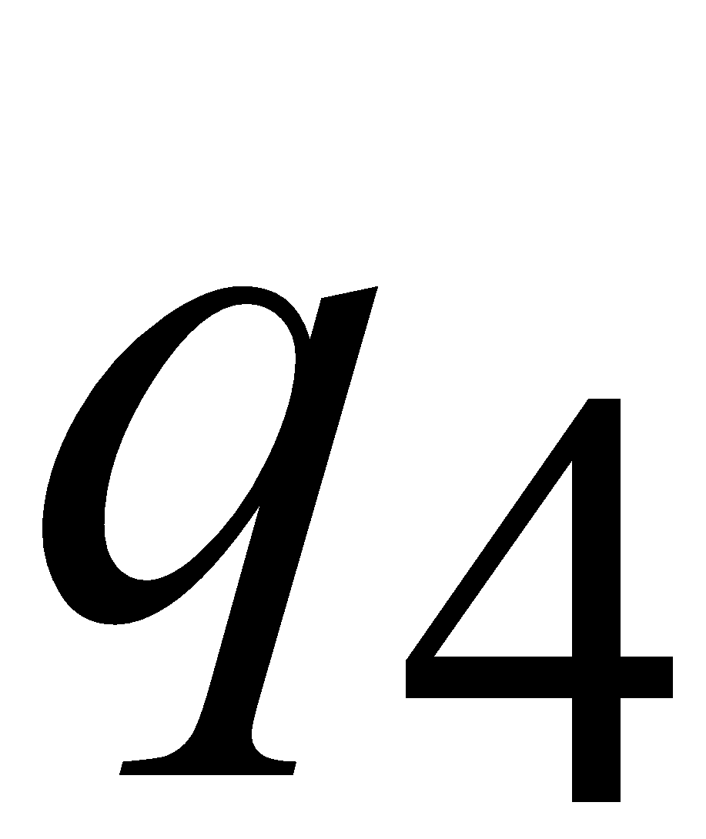
Consider the walk of a “long’’ string:
(length at least 4)
A state is repeated in the walk of
Costas Busch - LSU
‹#›

Slide 12
The state is repeated as a result of
the pigeonhole principle
Walk of
Pigeons:
(walk states)
Are more than
Nests:
(Automaton states)
Repeated
state
Repeated
state
Costas Busch - LSU
‹#›

Slide 13
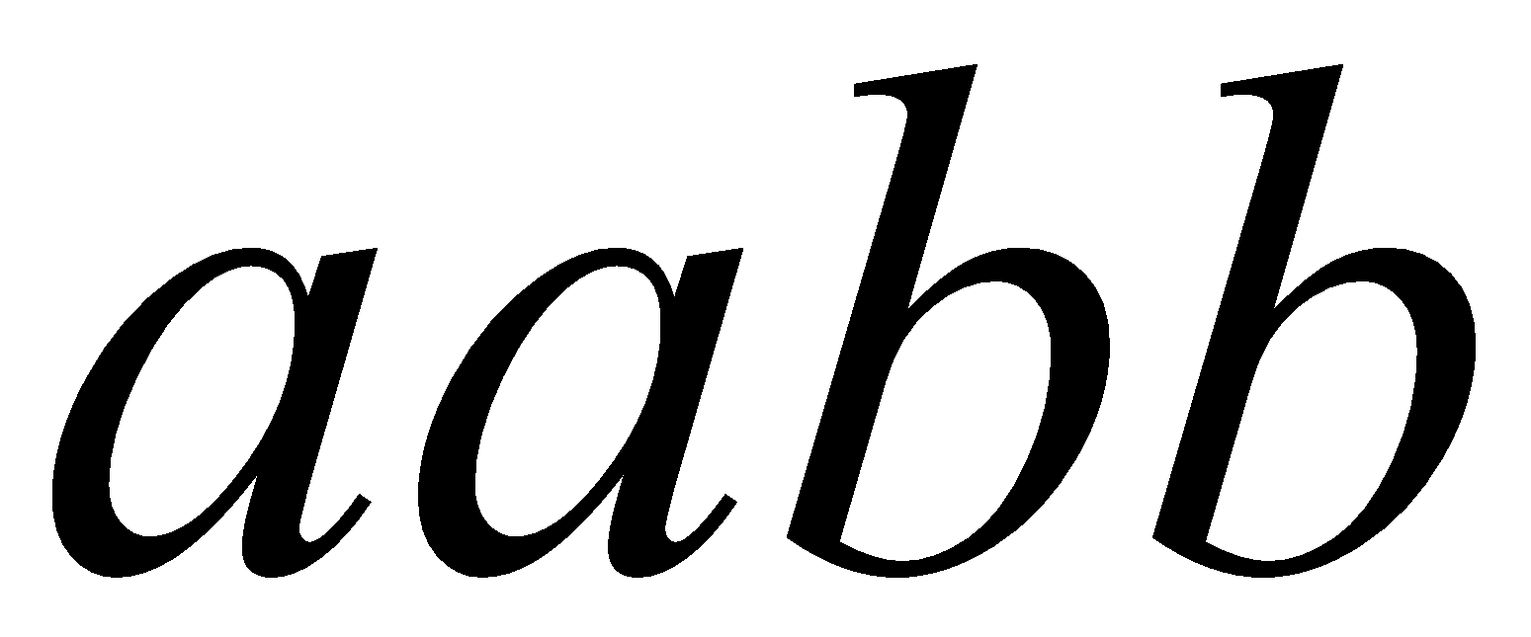
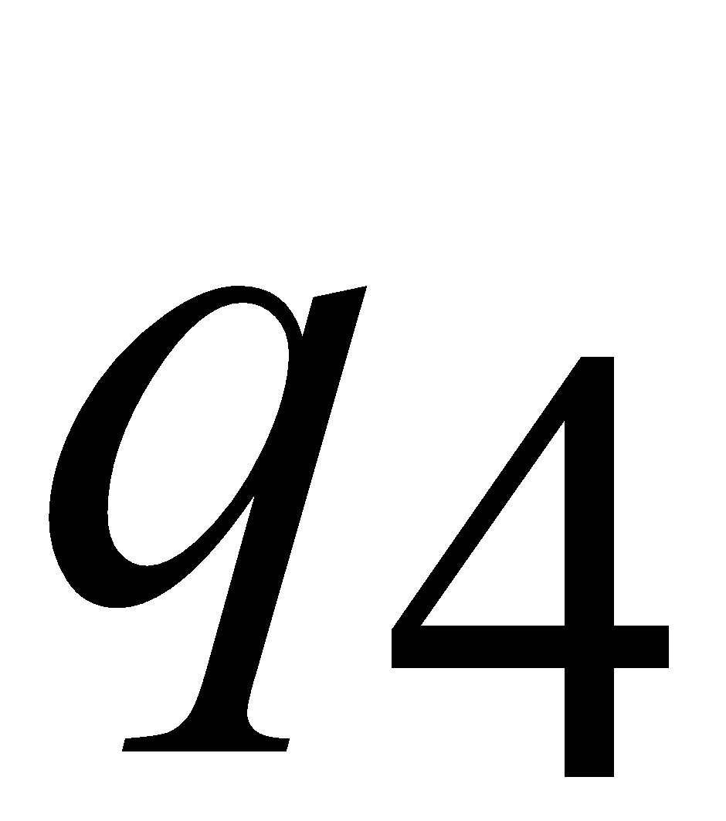
Consider the walk of a “long’’ string:
(length at least 4)
Due to the pigeonhole principle:
A state is repeated in the walk of
Costas Busch - LSU
‹#›

Slide 14
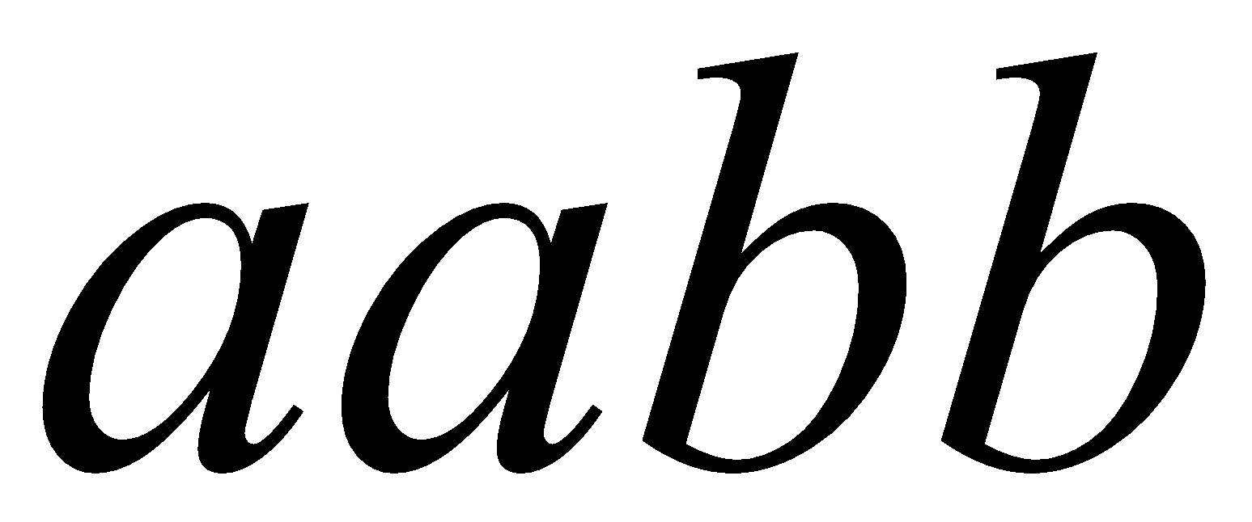
The state is repeated as a result of
the pigeonhole principle:
Walk of
Pigeons:
(walk states)
Are more than
Nests:
(Automaton states)
Automaton States
Repeated
state
Costas Busch - LSU
‹#›

Slide 15
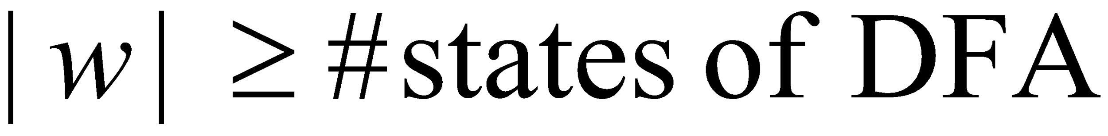
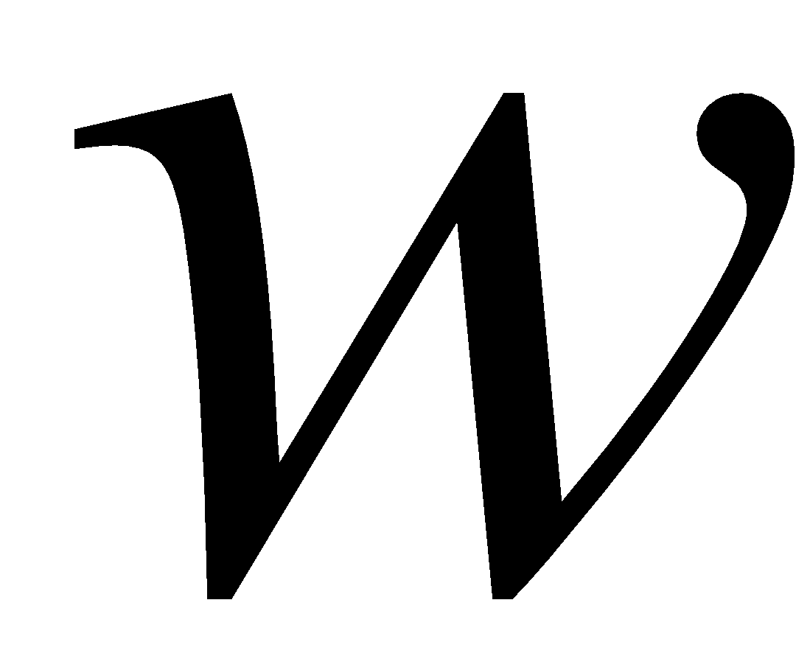
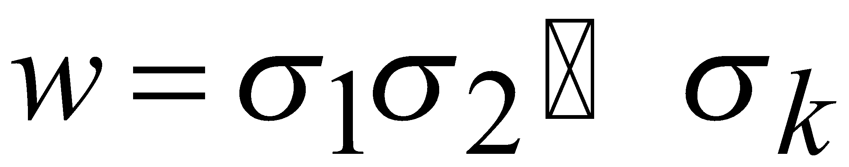
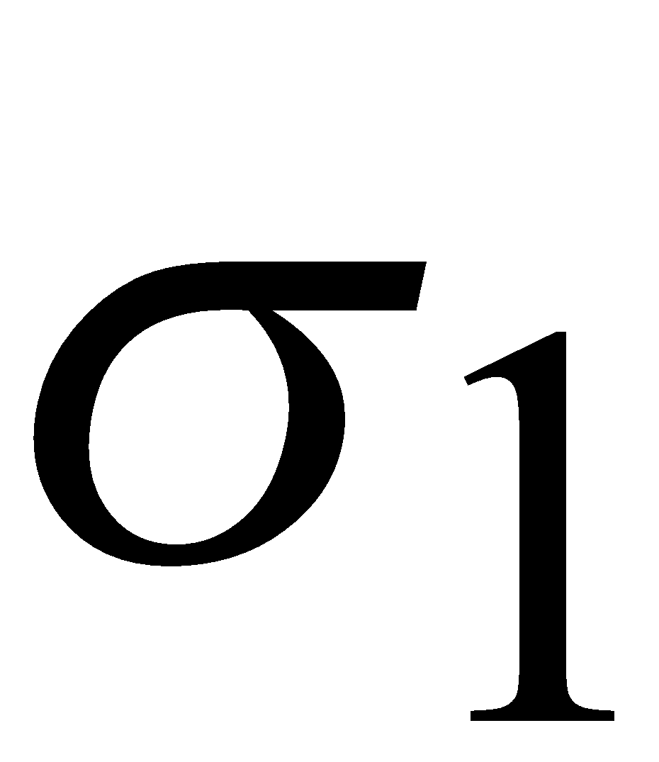
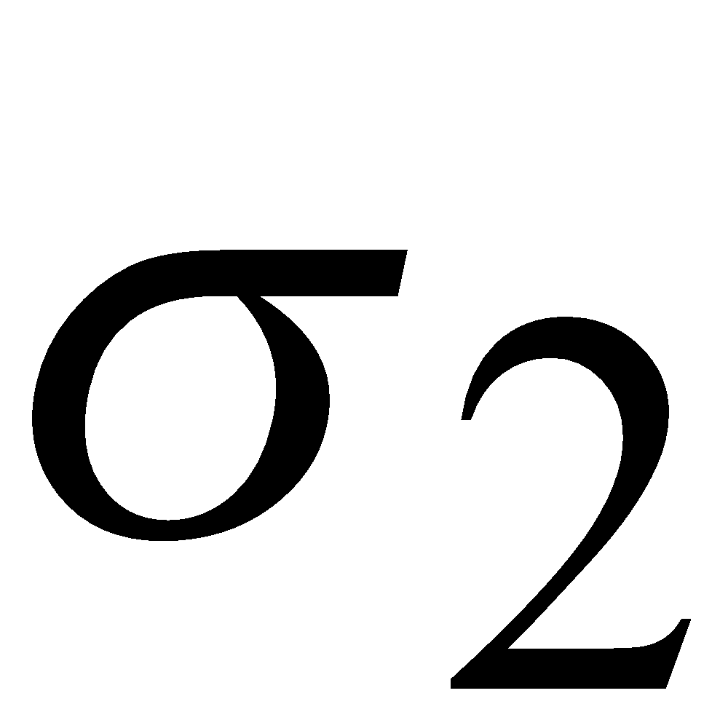
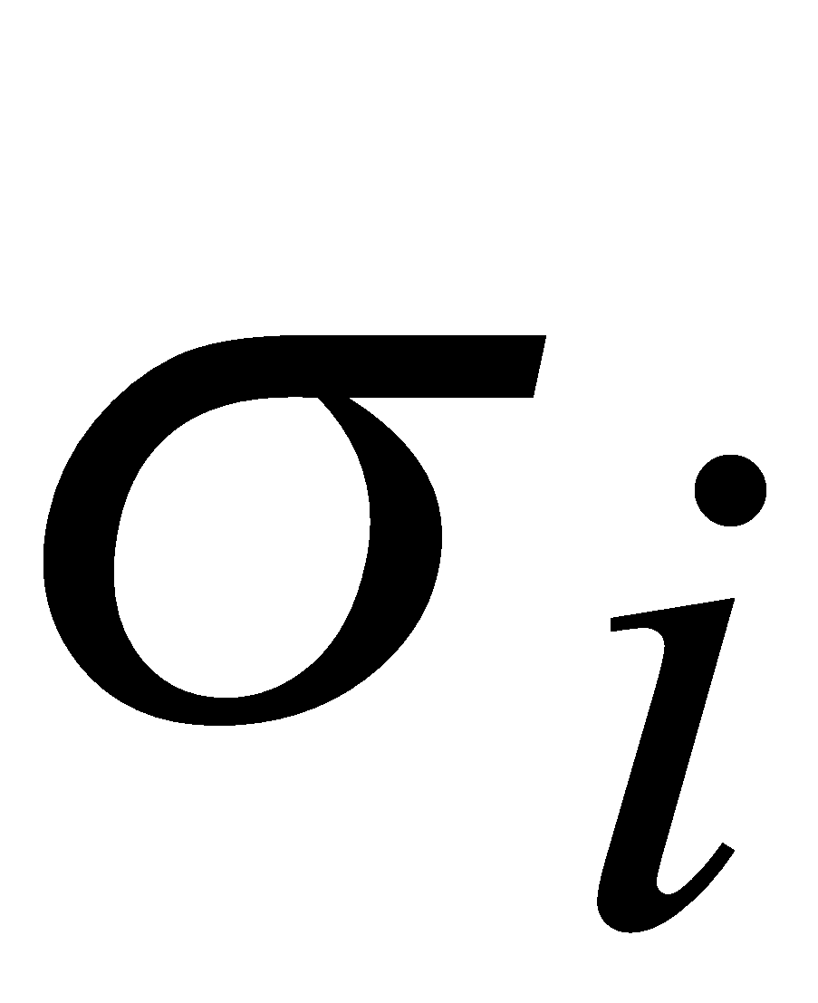
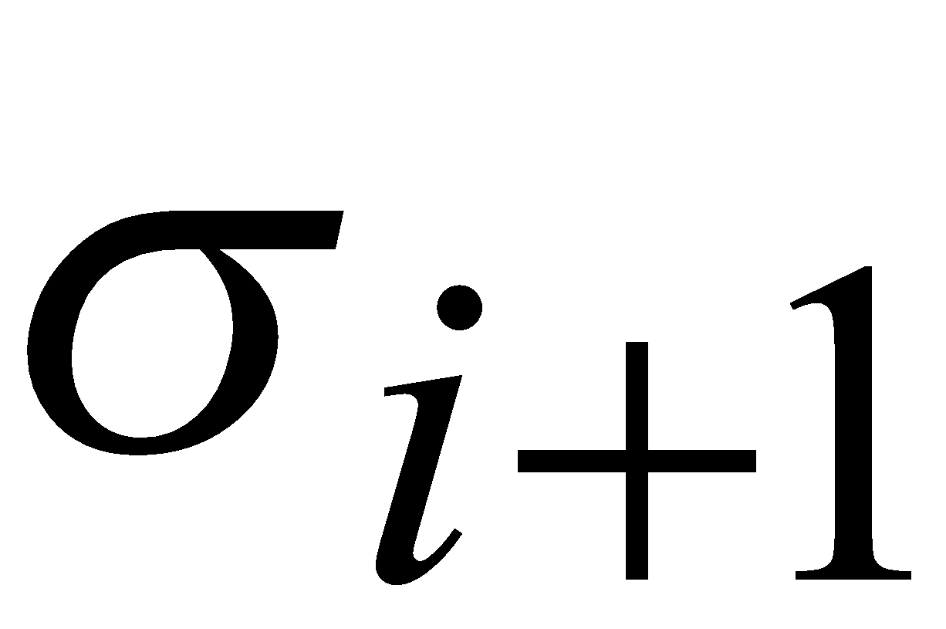
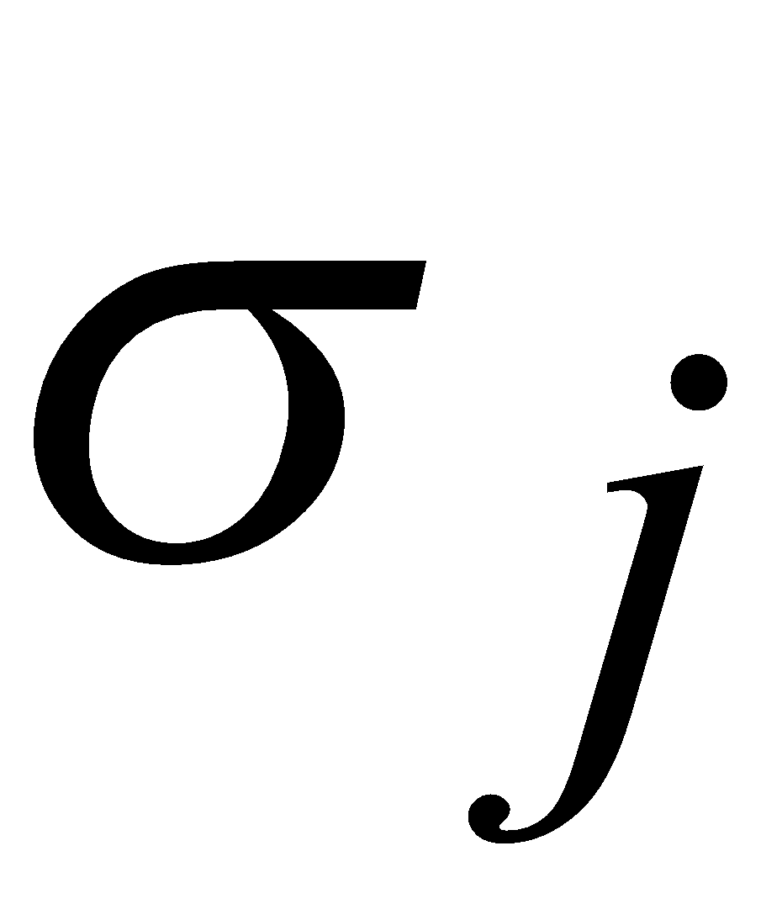
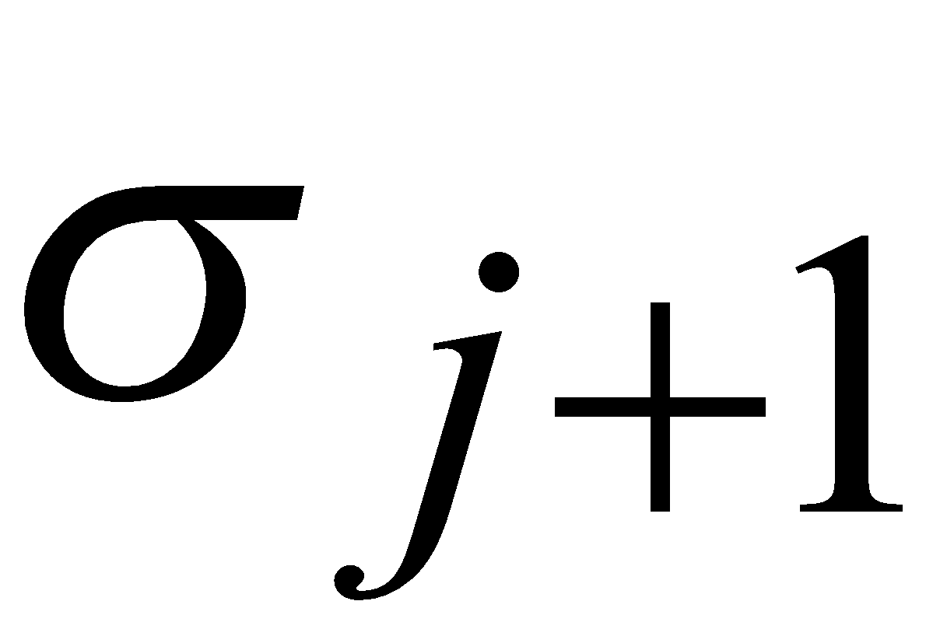
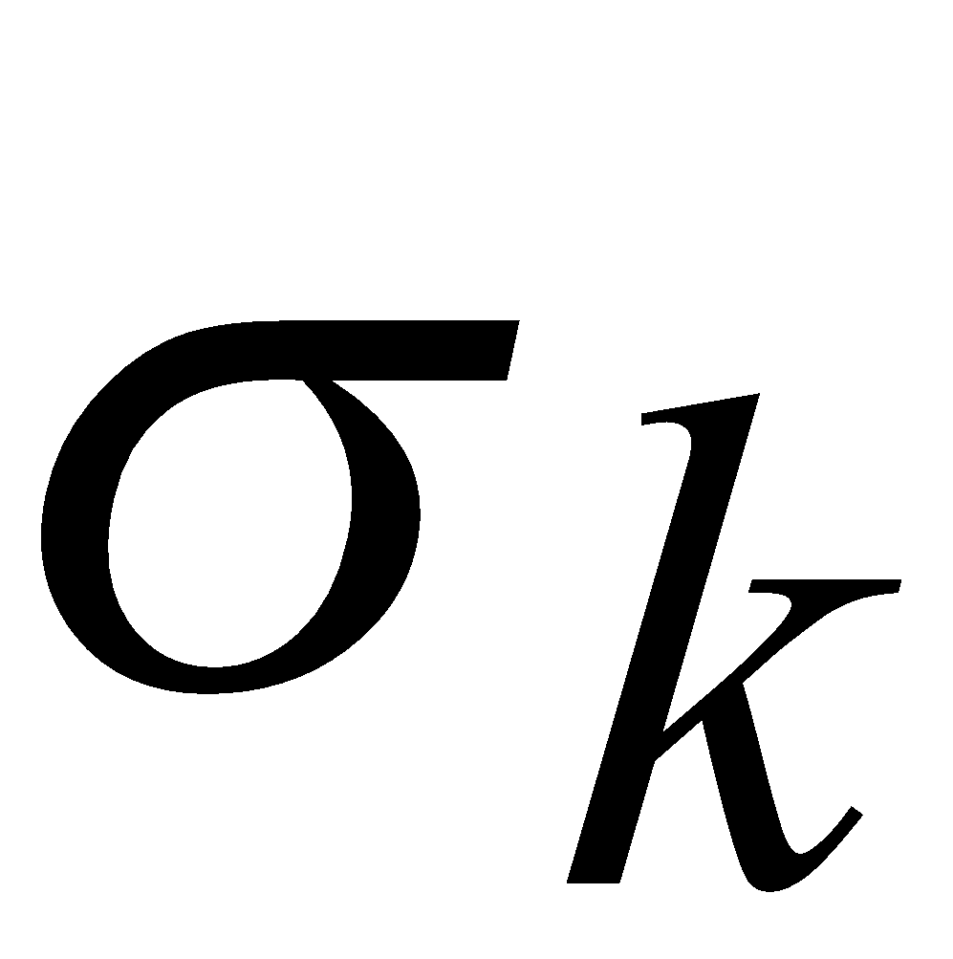
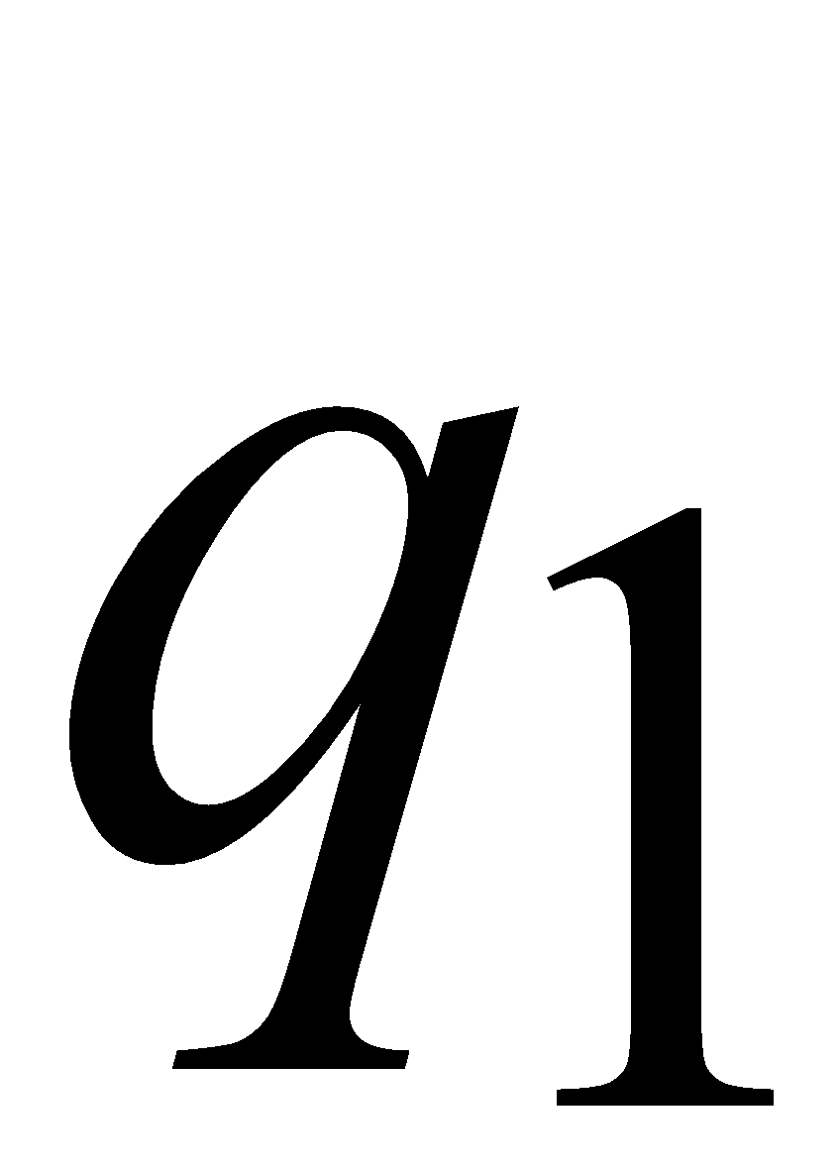
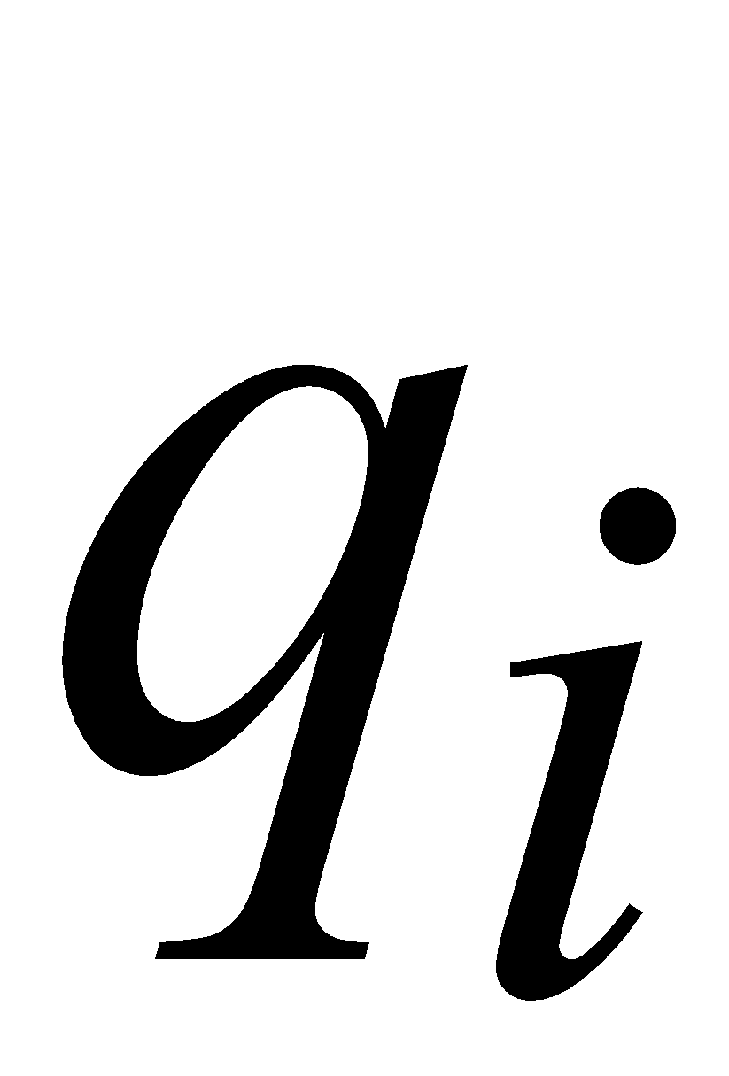
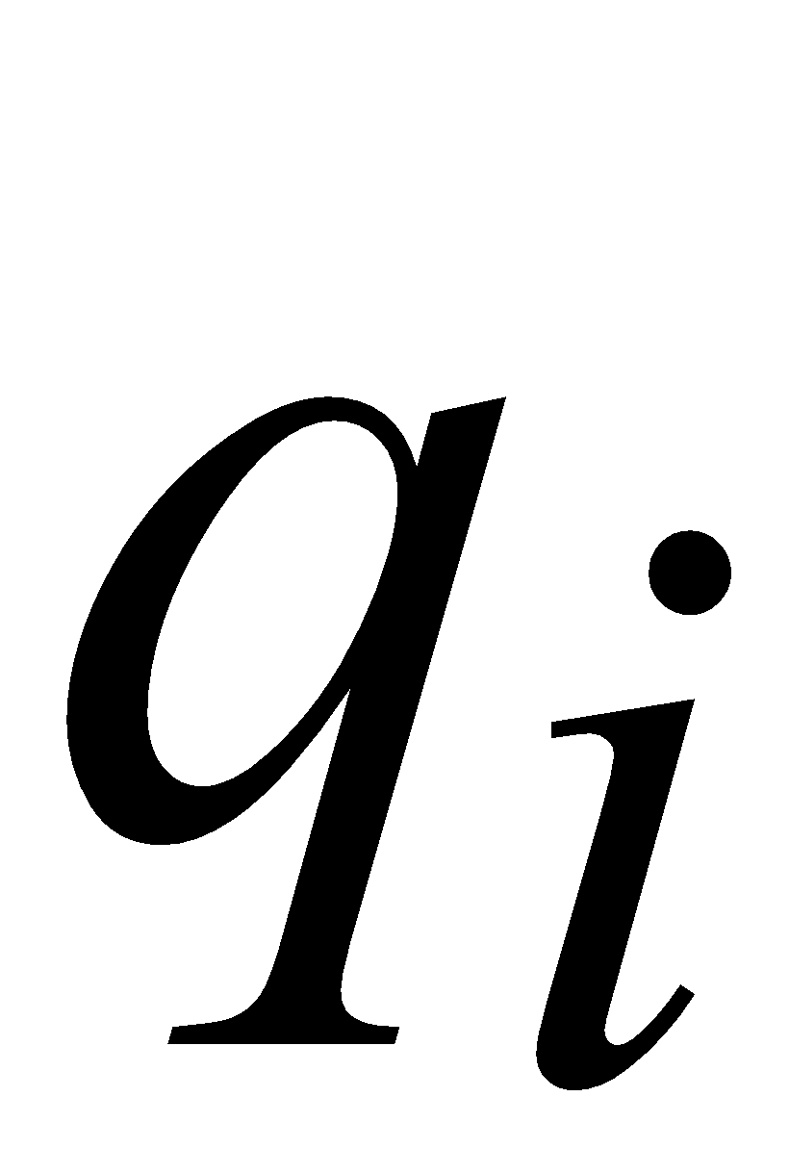
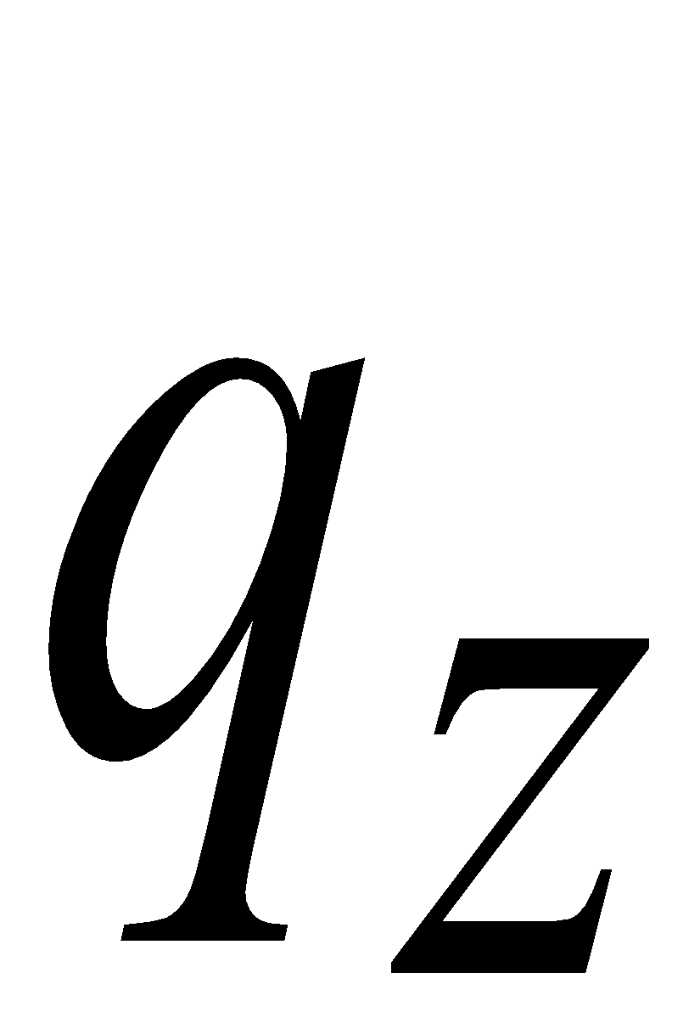
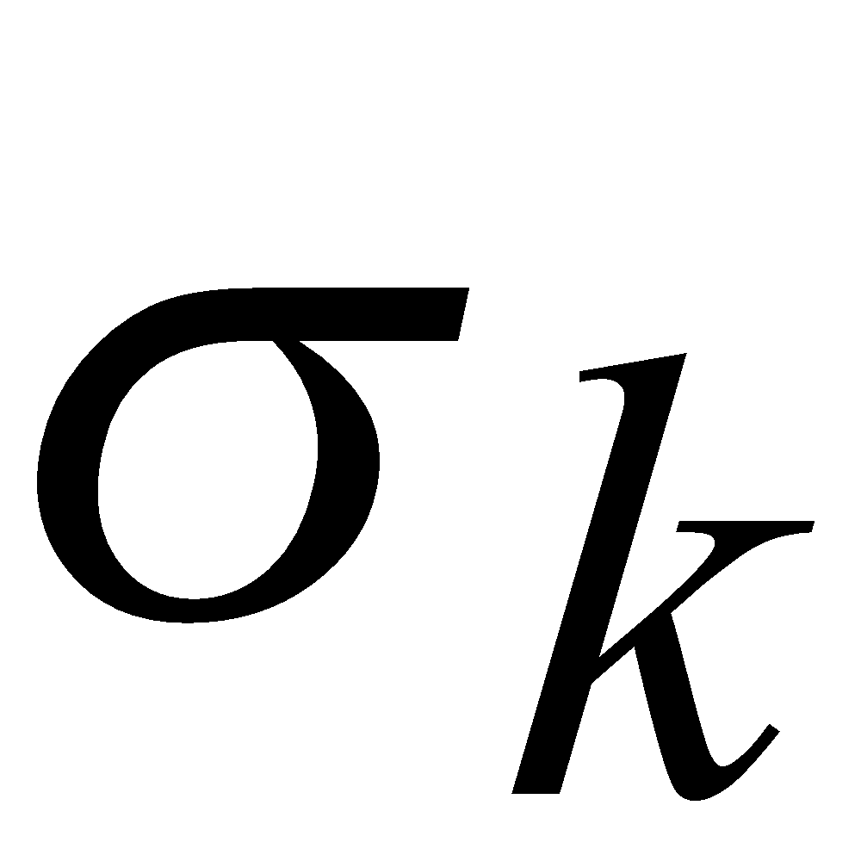
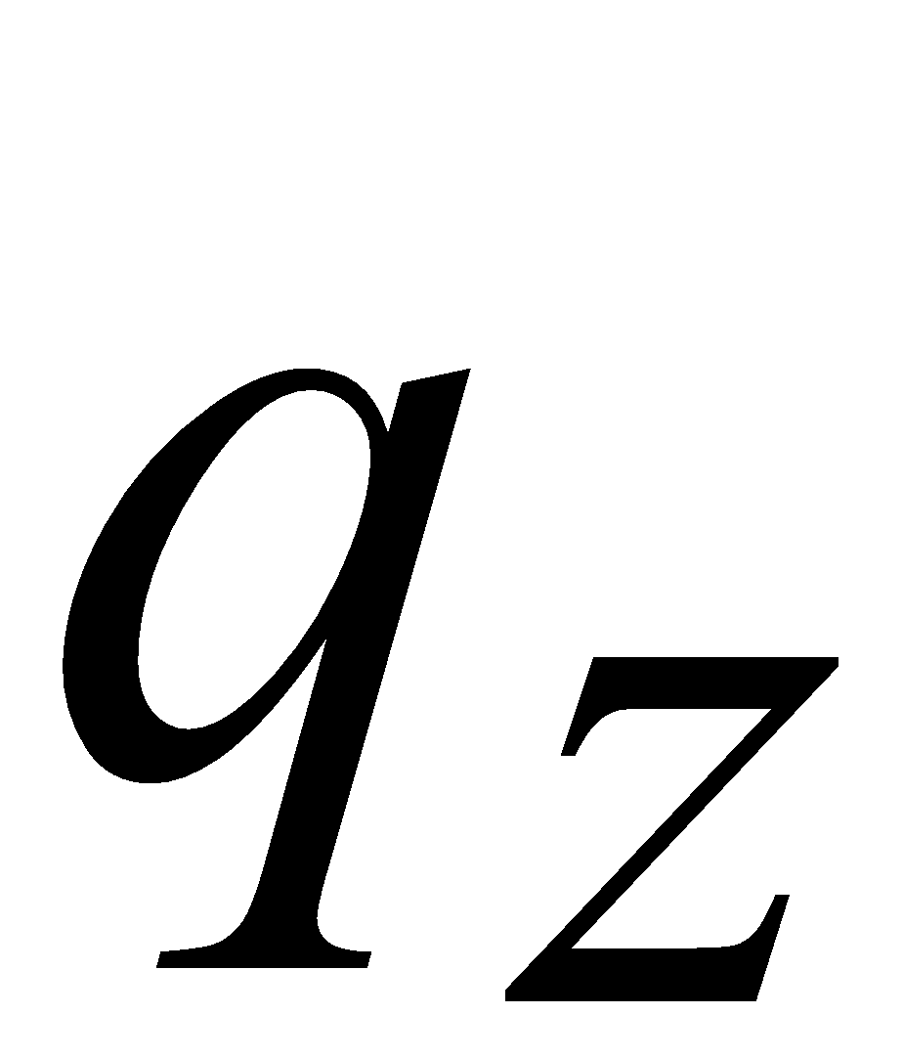
In General:
If ,
by the pigeonhole principle,
a state is repeated in the walk
Walk of
....
....
....
Arbitrary DFA
......
......
Repeated state
Costas Busch - LSU
‹#›

Slide 16
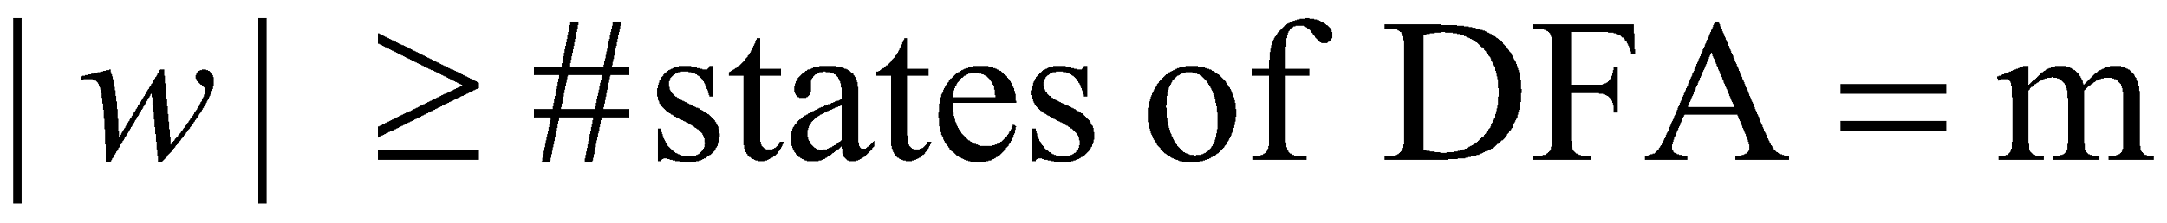
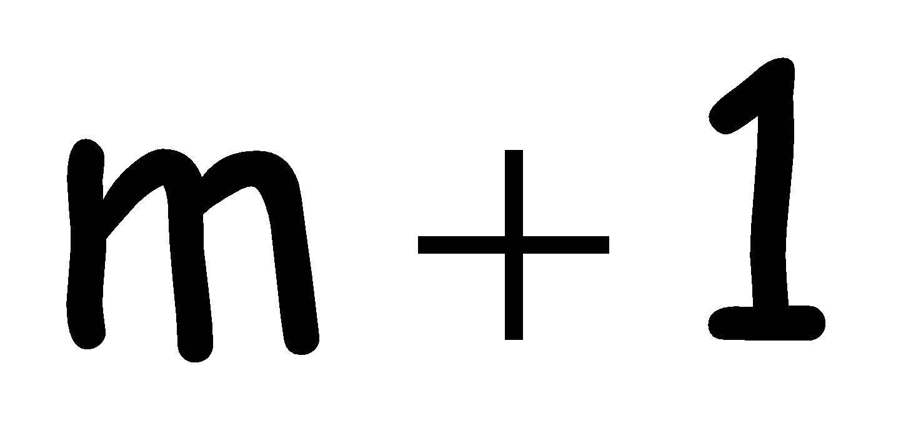
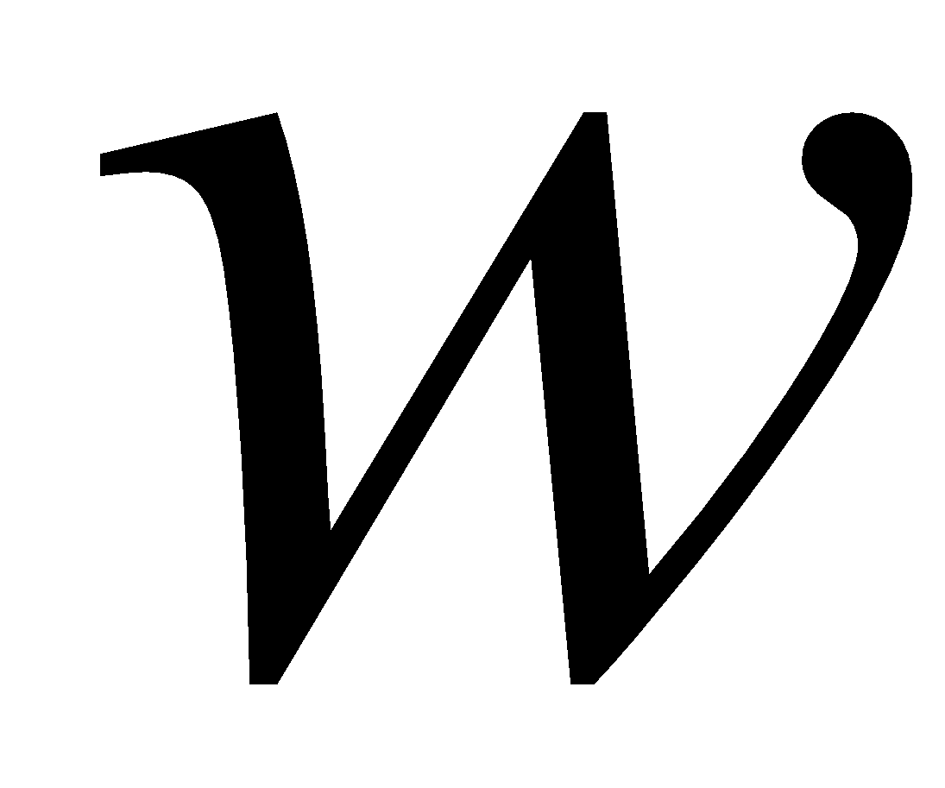
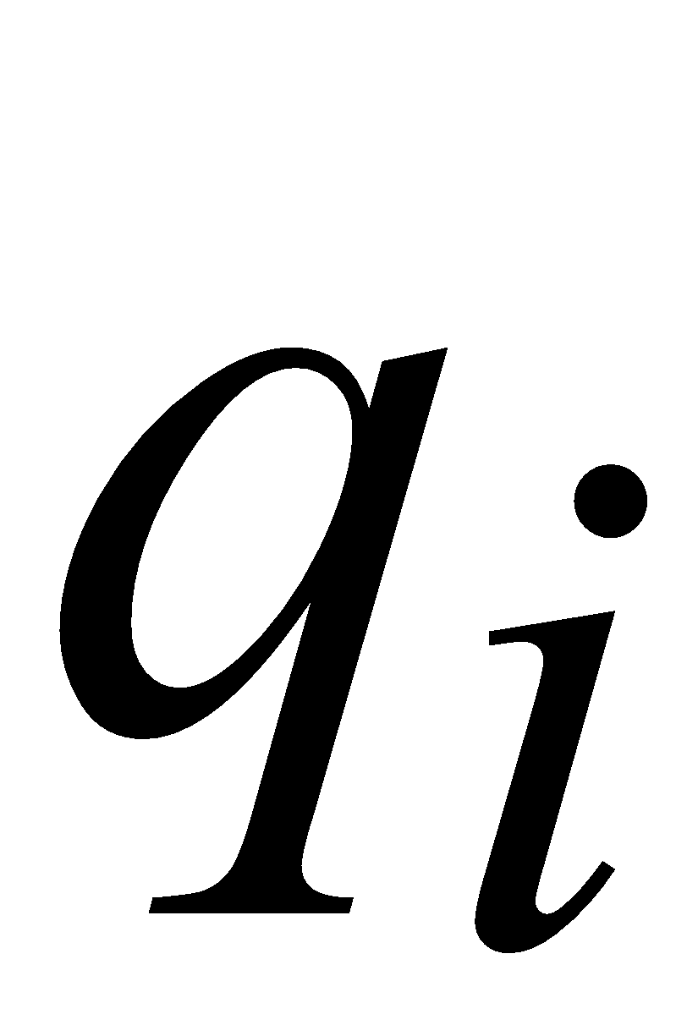
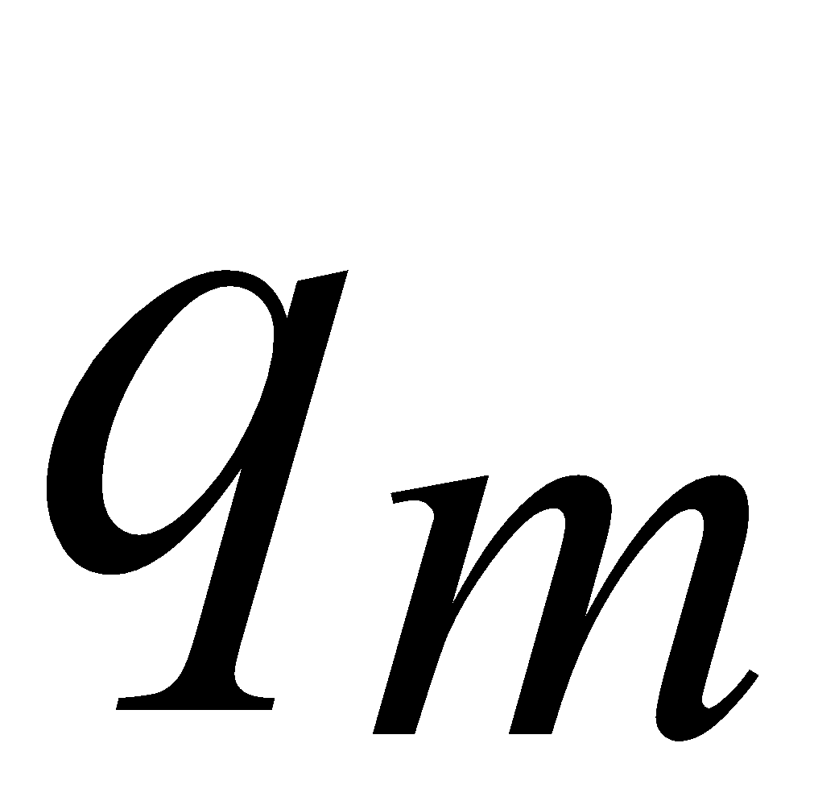

Number of states in walk is at least
Walk of
Pigeons:
(walk states)
....
....
....
Are
more
than
....
....
Nests:
(Automaton states)
A state is
repeated
Costas Busch - LSU
‹#›

Slide 17
The Pumping Lemma
Costas Busch - LSU
‹#›

Slide 18


Take an infinite regular language
(contains an infinite number of strings)
There exists a DFA that accepts
states
Costas Busch - LSU
‹#›

Slide 19





Take string with
(number of
states of DFA)
then, at least one state is repeated
in the walk of
Walk in DFA of
......
......
Repeated state in DFA
Costas Busch - LSU
‹#›

Slide 20


There could be many states repeated
Take to be the first state repeated
One dimensional projection of walk :
First
occurrence
Second
occurrence
....
....
....
Unique states
Costas Busch - LSU
‹#›

Slide 21





We can write
One dimensional projection of walk :
First
occurrence
Second
occurrence
....
....
....
Costas Busch - LSU
‹#›

Slide 22










In DFA:
Where corresponds to substring
between first and second occurrence of
...
...
...
...
Costas Busch - LSU
‹#›

Slide 23


Observation:
length
number
of states
of DFA
...
Because of
unique states in
...
Since, in no
state is repeated
(except q)
Costas Busch - LSU
‹#›

Slide 24

Observation:
length
Since there is at least one transition in loop
...
Costas Busch - LSU
‹#›

Slide 25


We do not care about the form of string
may actually overlap with the paths of and
...
...
Costas Busch - LSU
‹#›

Slide 26

Additional string:
The string
is accepted
Do not follow loop
...
...
...
...
Costas Busch - LSU
‹#›

Slide 27

Additional string:
The string
is accepted
Follow loop
2 times
...
...
...
...
Costas Busch - LSU
‹#›

Slide 28

Additional string:
The string
is accepted
Follow loop
3 times
...
...
...
...
Costas Busch - LSU
‹#›

Slide 29



In General:
The string
is accepted
Follow loop
times
...
...
...
...
Costas Busch - LSU
‹#›

Slide 30

Therefore:
Language accepted by the DFA
...
...
...
...
Costas Busch - LSU
‹#›

Slide 31
In other words, we described:
The Pumping Lemma !!!
Costas Busch - LSU
‹#›

Slide 32


The Pumping Lemma:
Given a infinite regular language
there exists an integer
(critical length)
for any string with length
we can write
with and
such that:
Costas Busch - LSU
‹#›

Slide 33


In the book:
Critical length = Pumping length
Costas Busch - LSU
‹#›

Slide 34
Applications of the Pumping Lemma
Costas Busch - LSU
‹#›

Slide 35
Observation:
Every language of finite size has to be regular
(we can easily construct an NFA
that accepts every string in the language)
Therefore, every non-regular language
has to be of infinite size
(contains an infinite number of strings)
Costas Busch - LSU
‹#›

Slide 36


Suppose you want to prove that
αn infinite language is not regular
1. Assume the opposite: is regular
2. The pumping lemma should hold for
3. Use the pumping lemma to obtain a
contradiction
4. Therefore, is not regular
Costas Busch - LSU
‹#›

Slide 37








Explanation of Step 3: How to get a contradiction
1. Let be the critical length for
2. Choose a particular string which satisfies
the length condition
3. Write
4. Show that
for some
5. This gives a contradiction, since from
pumping lemma
Costas Busch - LSU
‹#›

Slide 38

Note:
It suffices to show that
only one string
gives a contradiction
You don’t need to obtain
contradiction for every
Costas Busch - LSU
‹#›

Slide 39

Example of Pumping Lemma application
Theorem:
The language
is not regular
Proof:
Use the Pumping Lemma
Costas Busch - LSU
‹#›

Slide 40
Assume for contradiction
that is a regular language
Since is infinite
we can apply the Pumping Lemma
Costas Busch - LSU
‹#›

Slide 41


Let be the critical length for
Pick a string such that:
and length
We pick
Costas Busch - LSU
‹#›

Slide 42





From the Pumping Lemma:
we can write
with lengths
Thus:
Costas Busch - LSU
‹#›

Slide 43


From the Pumping Lemma:
Thus:
Costas Busch - LSU
‹#›

Slide 44



From the Pumping Lemma:
Thus:
Costas Busch - LSU
‹#›

Slide 45


BUT:
CONTRADICTION!!!
Costas Busch - LSU
‹#›

Slide 46
Therefore:
Our assumption that
is a regular language is not true
Conclusion:
is not a regular language
END OF PROOF
Costas Busch - LSU
‹#›

Slide 47

Non-regular language
Regular languages
Costas Busch - LSU
‹#›

